Slide 1
The real south Africa
Race, Reality, and Reasons for Hope
Hermann Pretorius

Slide 2
1. 2023 IRR Polling
2. Policies and politics
3. Key Takeaways

Slide 3
1. 2023 IRR Polling
2. Policies and politics
3. Key Takeaways

Slide 4
1. 2023 IRR Polling
Life in South Africa

Slide 5
Is your life better, the same as or worse than 5 years ago?
The real south Africa: race, reality, and reasons for hope

Slide 6
Do you think life 5 years from now will be better, the same or worse than today?
The real south Africa: race, reality, and reasons for hope

Slide 7
1. 2023 IRR Polling
Race relations

Slide 8
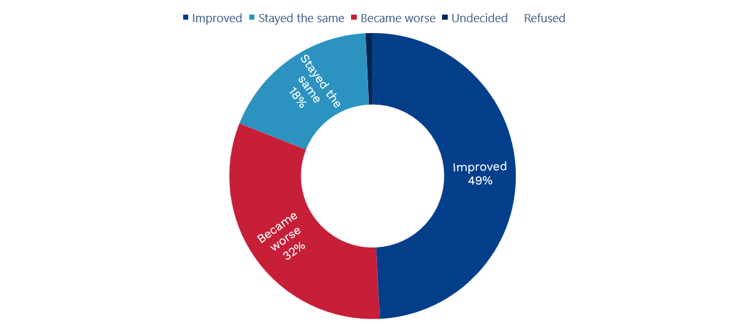
Since 1994, have relations between people of different races in South Africa improved, stayed the same or become worse?
The real south Africa: race, reality, and reasons for hope

Slide 9
Since 1994, have relations between people of different races in South Africa improved, stayed the same or become worse?
The real south Africa: race, reality, and reasons for hope

Slide 10
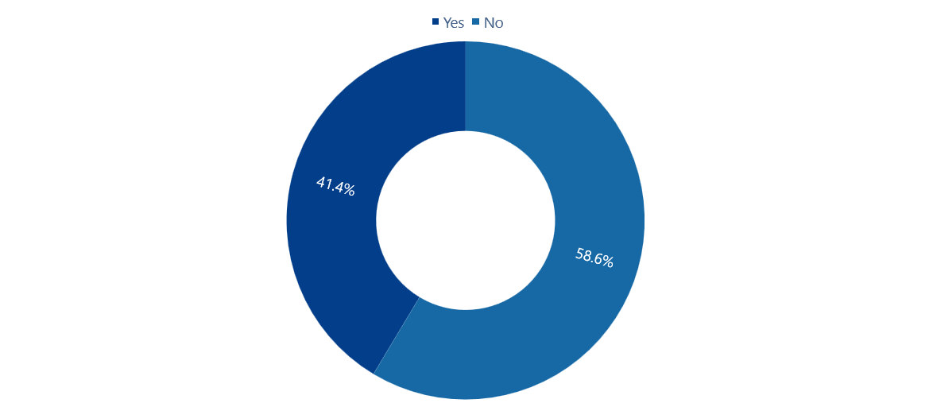
Have you personally experienced any form of racism in the past five years?
The real south Africa: race, reality, and reasons for hope

Slide 11
Have you personally experienced any form of racism in the past five years?
The real south Africa: race, reality, and reasons for hope

Slide 12
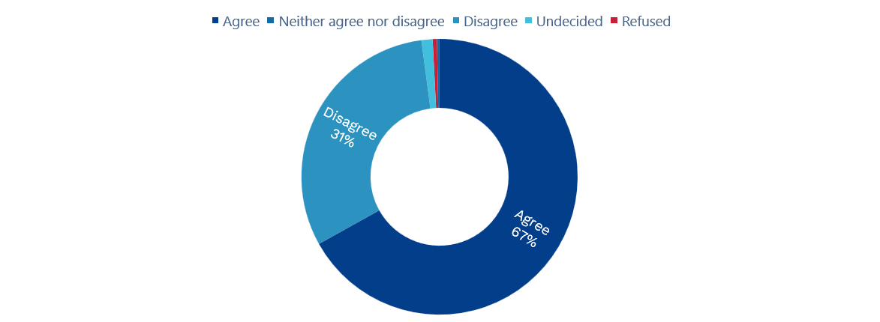
All this talk of racism and colonialism is by politicians who are trying to find excuses for their own failures. Do you agree or disagree with this statement?
The real south Africa: race, reality, and reasons for hope

Slide 13
All this talk of racism and colonialism is by politicians who are trying to find excuses for their own failures. Do you agree or disagree with this statement?
The real south Africa: race, reality, and reasons for hope

Slide 14
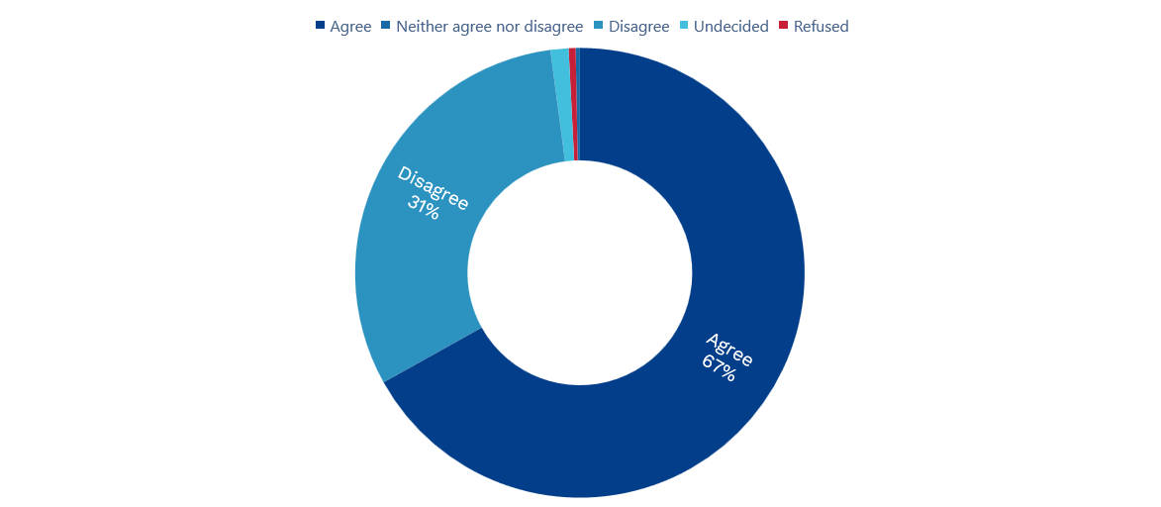
Do the different races need each other for progress and should there be full opportunity for all?
The real south Africa: race, reality, and reasons for hope

Slide 15
Do the different races need each other for progress and should there be full opportunity for all?
The real south Africa: race, reality, and reasons for hope

Slide 16
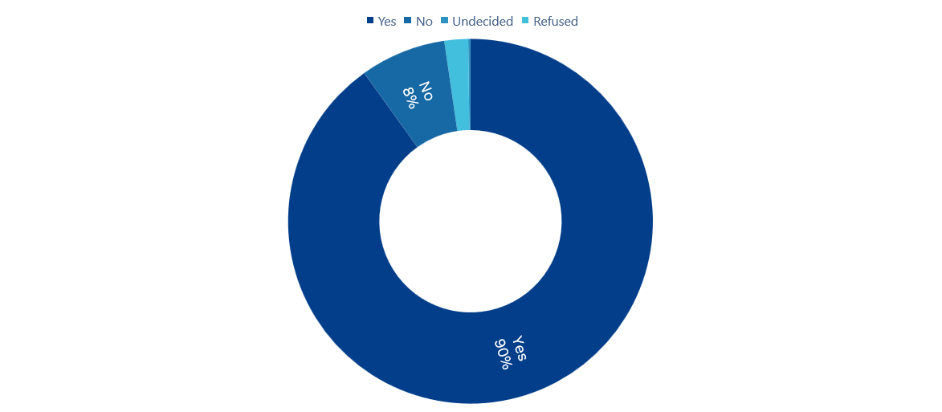
Do you believe that South African sports teams should be selected only on merit and ability and not by racial quotas?
The real south Africa: race, reality, and reasons for hope

Slide 17
Do you believe that South African sports teams should be selected only on merit and ability and not by racial quotas?
The real south Africa: race, reality, and reasons for hope

Slide 18
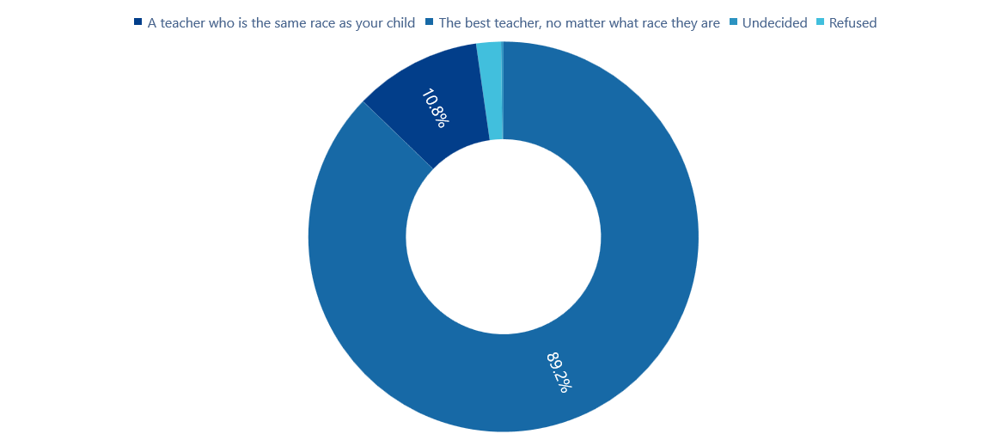
Do you believe that South African sports teams should be selected only on merit and ability and not by racial quotas?
The real south Africa: race, reality, and reasons for hope

Slide 19
Do you believe that South African sports teams should be selected only on merit and ability and not by racial quotas?
The real south Africa: race, reality, and reasons for hope

Slide 20
What impact does illegal immigration have on SA’s unemployment numbers?
The real south Africa: race, reality, and reasons for hope

Slide 21
Do you prefer a political party which promises faster economic growth and more jobs or one which promises land expropriation without compensation as redress for past wrongs?
The real south Africa: race, reality, and reasons for hope

Slide 22
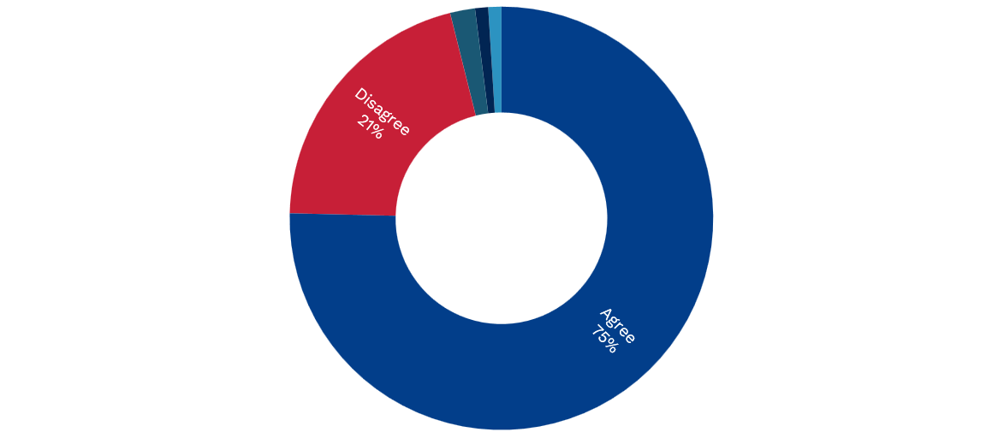
Will better education and more jobs decrease inequality within South Africa?
The real south Africa: race, reality, and reasons for hope

Slide 23
1. 2023 IRR Polling
2. Policies and politics
3. Key Takeaways

Slide 24
What should the top two priorities of the government be?
The real south Africa: race, reality, and reasons for hope

Slide 25

In your opinion, would tax-funded vouchers for schooling, health care, and housing be more effective in helping you to get ahead than current AA and BEE policies, which focus on management posts, ownership deals, and preferential tenders?
The real south Africa: race, reality, and reasons for hope

Slide 26
In your opinion, would tax-funded vouchers for schooling, health care, and housing be more effective in helping you to get ahead than current AA and BEE policies, which focus on management posts, ownership deals, and preferential tenders?
The real south Africa: race, reality, and reasons for hope

Slide 27
What are the chances of you voting in the 2024 general elections?
The real south Africa: race, reality, and reasons for hope
Notes:
Our poll only included registered voters. In 2019 66% of registered voters actually voted.
So this 80.9% should be taken with a pinch of salt – it could be survey respondents virtue signalling, or sincerely believing they’re going to go and vote even though not all of them will.

Slide 28
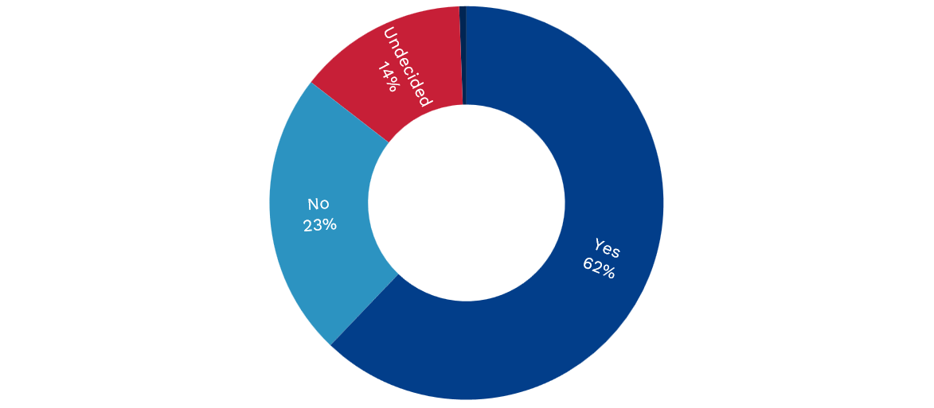
Will the 2024 national elections be free and fair?
The real south Africa: race, reality, and reasons for hope

Slide 29
Reasons for not voting in the 2024 general elections
The real south Africa: race, reality, and reasons for hope

Slide 30
What reaction are you anticipating from the ANC, should they lose the 2024 election?
The real south Africa: race, reality, and reasons for hope

Slide 31
By-elections (since 2021 LGE)
The real south Africa: race, reality, and reasons for hope
 | Hold | Gain | Loss | Net
ANC | 87 | 7 | 23 | -16
IFP | 12 | 12 | 2 | 10
NFP | 1 | 1 | 0 | 1
African United Movement | 0 | 1 | 1 | 0
Independent | 0 | 2 | 3 | -1
DA | 35 | 4 | 5 | -1
EFF | 1 | 9 | 0 | 9
PA | 0 | 4 | 1 | 3
KGP | 0 | 0 | 1 | -1
Al Jama-ah | 0 | 0 | 1 | -1
FF+ | 0 | 1 | 1 | 0
TSSA | 1 | 0 | 0 | 0
CRFA | 1 | 0 | 0 | 0
GOOD | 0 | 0 | 3 | -3

Slide 32
Leaders’ favourability
The real south Africa: race, reality, and reasons for hope

Slide 33
Leaders’ unfavourability
The real south Africa: race, reality, and reasons for hope

Slide 34
If the general election was today, who would you vote for?
The real south Africa: race, reality, and reasons for hope

Slide 35
1. 2023 IRR Polling
2. Policies and politics
3. Key Takeaways

Slide 36
How the ANC’s 2024 performance is likely to set the political course following 2024 NPE
The real south Africa: race, reality, and reasons for hope

Slide 37
Key political scenarios for 2024
The real south Africa: race, reality, and reasons for hope
Volatility
DA +others
ANC +DA
ANC +EFF
ANC +others
ANC 50+
Stability
Business as usual
Impact/disruption

Slide 38
Key takeaways
The real south Africa: race, reality, and reasons for hope
  Race relations in South Africa are sound, but with underlying negative shifts amongst races excluded from government policies like BEE
  South Africa is in the era of coalitions for the foreseeable future
  Increased uncertainty the likely driver of upsurge in anti-illegal immigrant convictions
  South Africans are driven by concerns over opportunities and safety
  The socio-political landscape of South Africa offers close to a blank slate for change

Slide 39
1. 2023 IRR Polling
2. Policies and politics
3. Key Takeaways

Slide 40
The real south Africa
Race, Reality, and Reasons for Hope
Hermann Pretorius

